Slide 1
Note: For better understanding, this ppt should be used synchronously with the audio file attached.
Class : VI ^{TH} SUBJECT : SCIENCE
CHAPTER 6
CHANGES AROUND US
MODULE II

Slide 2
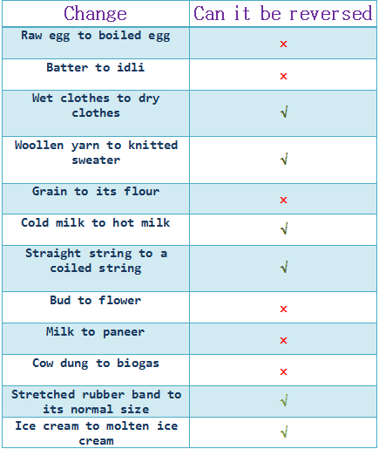
TABLE 6.1

Slide 3
DIFFERENT WAYS TO BRING CHANGES
CUTTING
APPLYING PRESSURE
DISSOLVING SOMETHING IN WATER
MIXING TWO OR MORE THINGS TOGETHER
HOT AND COLD TREATMENT ( HEATING / COOLING SOMETHING TO BRING A CHANGE)

Slide 4
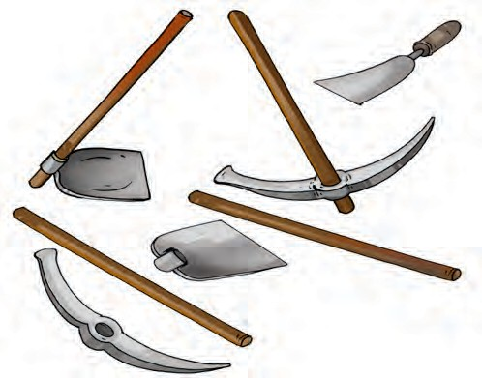
These are some of the Tools used in the garden/ agriculture
●

Slide 5
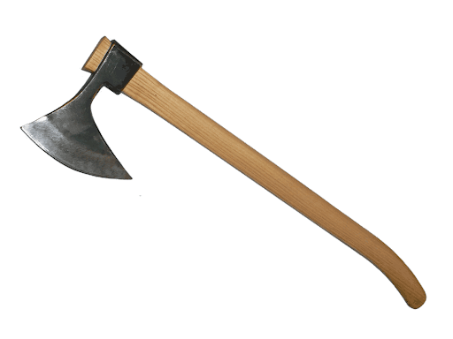
How is the wooden handle fixed to the iron blade of these tools?
The iron blade of these tools has a ring in which the wooden handle is fixed. Normally, the ring is slightly smaller in size than the wooden handle. To fix the handle, the ring is heated and it becomes slightly larger in size (expands). Now, the handle easily fits into the ring. When the ring cools down it contracts and fits tightly on to the handle.
●

Slide 6
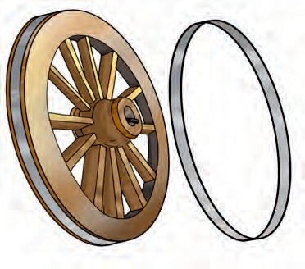
For fixing the metal rim on a wooden wheel of a cart . Again the metal rim is made slightly smaller than the wooden wheel. On heating, the rim expands and fits onto the wheel. Cold water is then poured over the rim, which contracts and fits tightly onto the wheel.
●

Slide 7
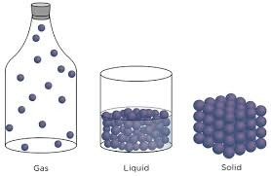
EXPANSION AND CONTRACTION
Decreasing temperature

Slide 8
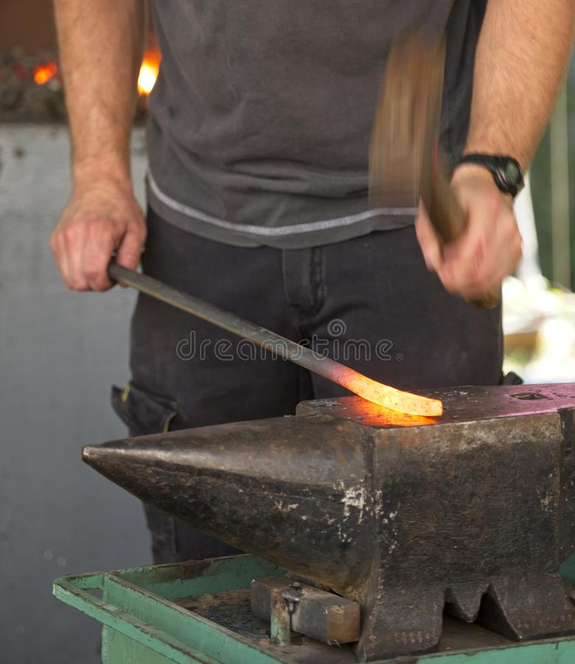
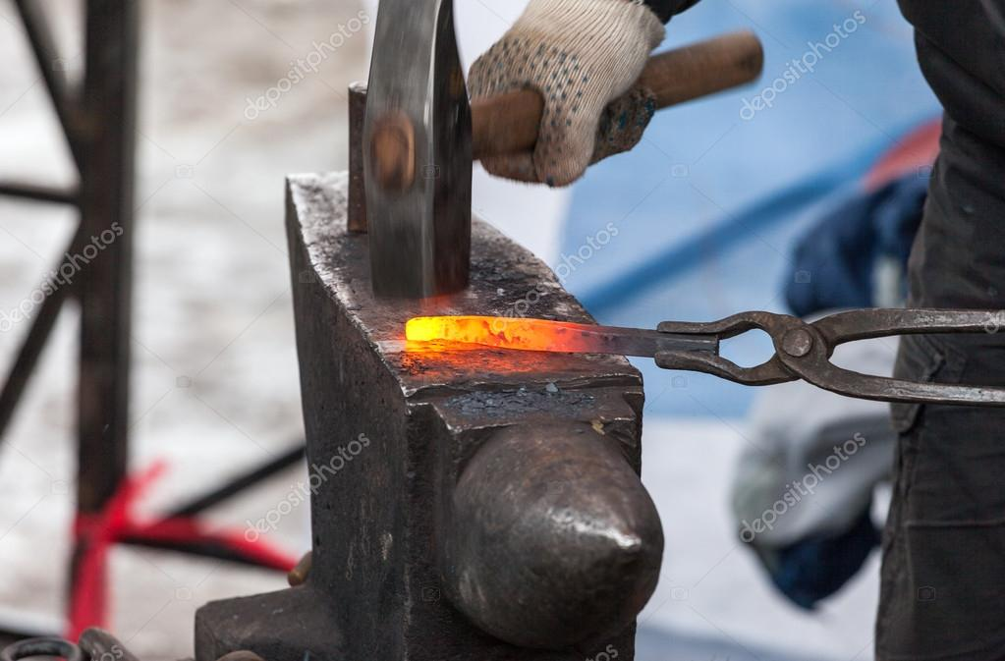
Blacksmith making iron tools.
Can this change be reversed?

Slide 9
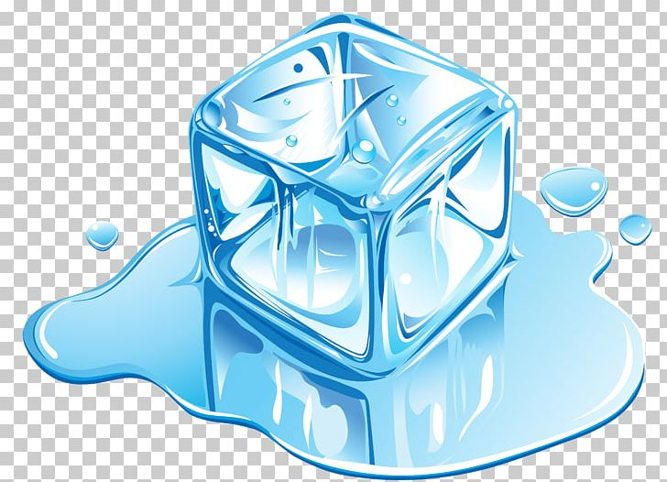
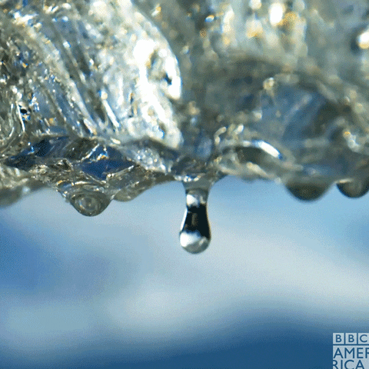
Melting of ice/ Expansion of ice particles

Slide 10
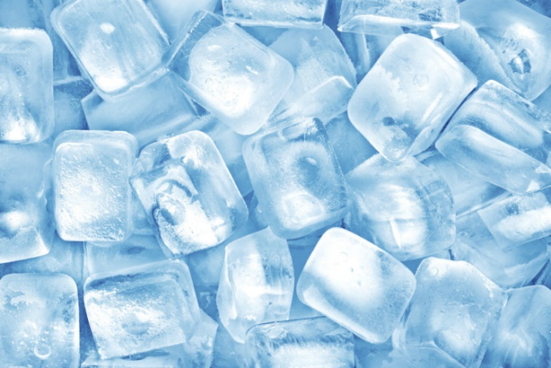
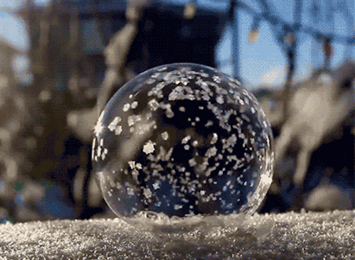
Freezing of water/ contraction of water particles

Slide 11
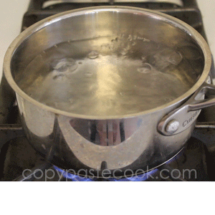
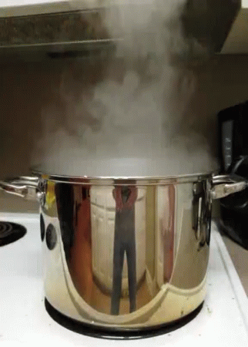
Boiling of water/ expansion of water

Slide 12
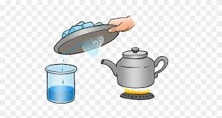
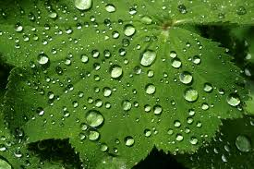
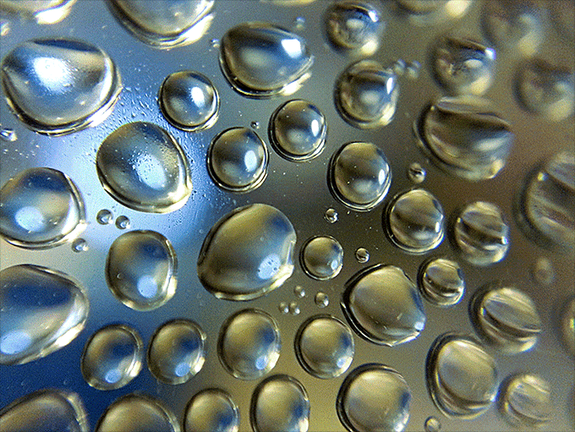
Condensation/ contraction of steam particles

Slide 13
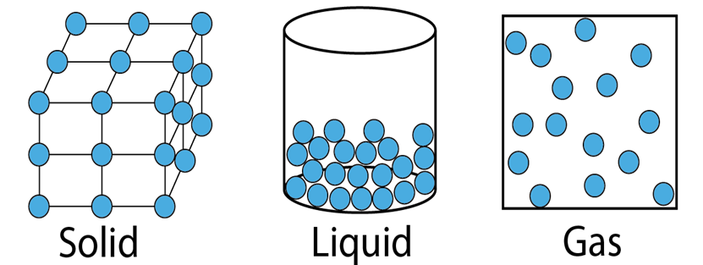
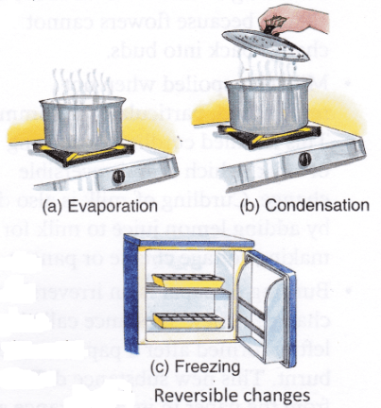
Interconversion of the three states of water is reversible.

Slide 14
EFFECTS OF CHANGE IN TEMPERATURE
MATERIALS EXPAND ON HEATING.
MATERIALS CONTRACT ON COOLING.
SOLIDS EXPAND AND CONTRACT THE LEAST.
GASES EXPAND AND CONTRACT THE MOST .
MELTING & VAPORIZATION ARE EXAMPLES OF EXPANSION.
FREEZING & CONDENSATION ARE EXAMPLES OF CONTRACTION.

Slide 15
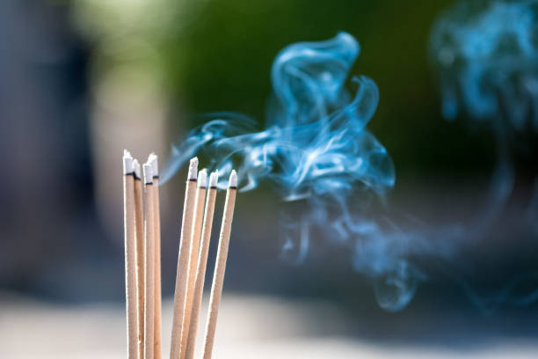
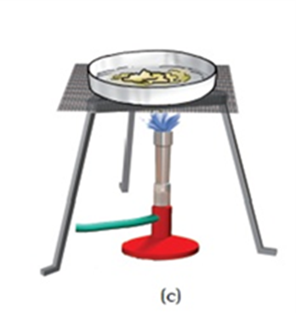
Burning of candle and heating of wax
HEATING OF WAX

Slide 16
Evaporation and condensation

Slide 17
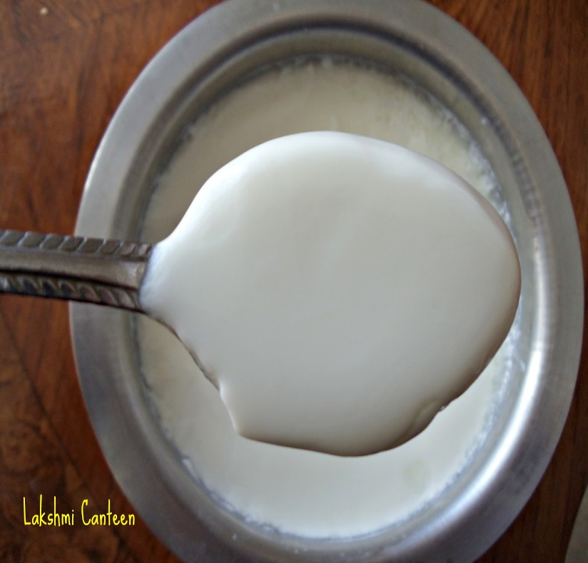
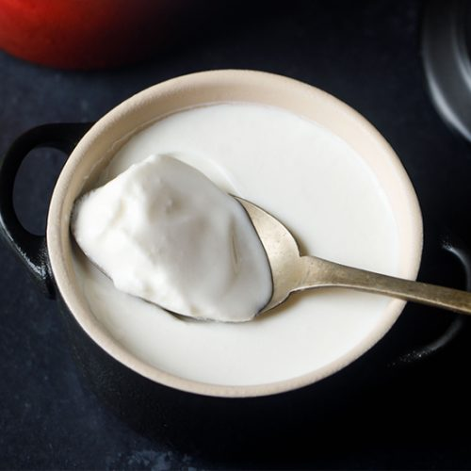
Curd formation

Slide 18
Summary
some changes can be reversed, while some others cannot be reversed.
There are many ways of changing things around us such as…
dissolving something in water, mixing two or more things together, heating or cooling.

Slide 19
Assignment
Do the exercise questions in your notebook.
Also perform the suggested activities and projects given at the end of the chapter in your textbook.

Slide 20
Prepared by
Girija Pal
TGT
AECS 1, Mumbai

